Slide 1
Forest Fire Detection System
Created By: Sharad Kumar Pani
upGrad
24-03-2025

Slide 2
"Why Fire Detection is Important?"
Wildfires and accidental fires cause environmental and economic damage.
Traditional smoke sensors are slow and ineffective for detecting distant fires.
A deep-learning-based fire detection system can provide faster and more accurate alerts.
Our goal: Build a fire detection model using CNNs and image classification.

Slide 3
"Challenges in Fire Detection"
Slow Response Time → Traditional sensors detect fire only after significant damage.
False Alarms → Smoke from vehicles or cooking can trigger false alerts.
High Cost → Setting up multiple physical sensors is expensive.
Difficult Terrains → Remote forests & industrial zones lack proper monitoring.
Our Solution: A computer vision model that detects fire from surveillance cameras.

Slide 4
What Are We Trying to Achieve?
🔍 Develop a deep learning model to classify images as Fire, Non-Fire, or Smoke.
🎯 Achieve an accuracy of 95%+ on test data.
🚀 Deploy the model as a real-time system for fire monitoring.
📡 Reduce false alarms by improving model precision.

Slide 5
Dataset Description
Dataset name: Forest Fire, Smoke, Non Fire
Total 36,000 + images
Fire: 10500, Smoke:10500, Non-Fire: 10500 (Training Set)
Fire: 3500, Smoke:3500, Non-Fire: 3500 (Testing Set)
Image Size: 224, 224, 3

Slide 6
Deep Learning Model: CNN Architecture
We used a Convolutional Neural Network (CNN) for image classification.
Layers Used:
Conv2D + ReLU Activation → Feature extraction
MaxPooling2D → Reducing dimensionality
Flatten → Convert features into a single vector
Dense (Fully Connected Layer) → Final classification
Dropout (0.5) used to prevent overfitting.

Slide 7
Model Training & Hyperparameters
Loss Function: Categorical Cross-Entropy
Optimizer: Adam
Batch Size: 32
Epochs: 7 (Early Stopping Used)
Learning Rate Scheduler: Reduces LR when validation loss stops improving

Slide 8
How We Prevented Overfitting
Dropout (0.5) → Prevents the model from memorizing specific images.
Data Augmentation → Increases image diversity using:
Rotation, Flipping, Shearing, Zooming
Early Stopping → Stops training when validation loss increases.

Slide 9
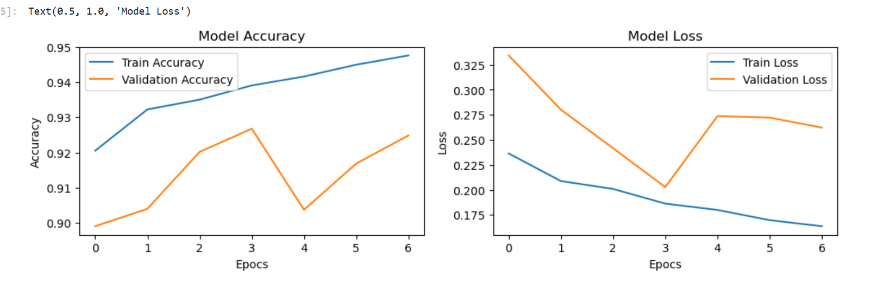
Model Accuracy

Slide 10
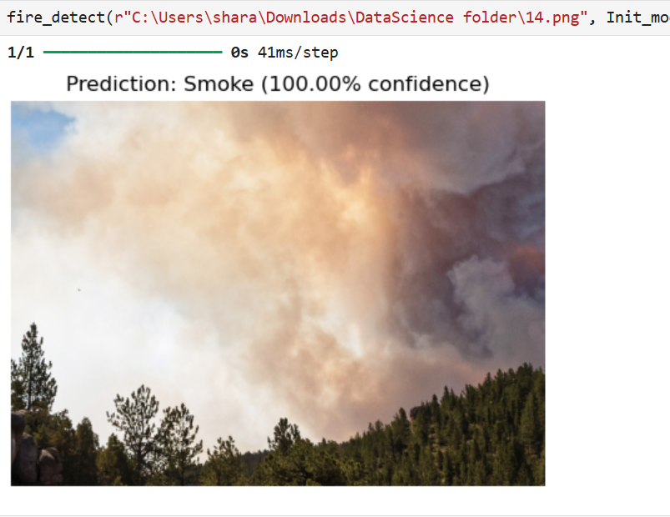
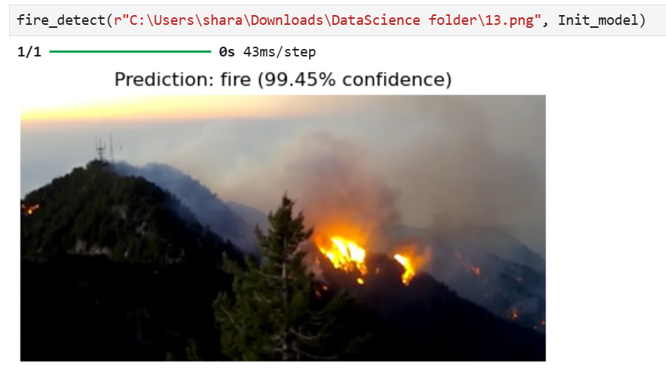
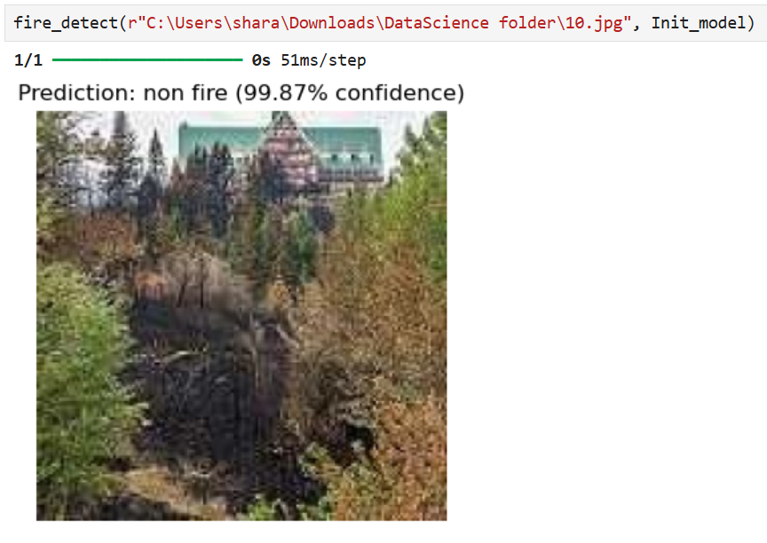
Real time Predictions

Slide 11
Final Thoughts & Next Steps
Successfully built a fire detection model with 97% accuracy.
Can be deployed in real-time for wildfire monitoring.
Future Work:
Use real-time video input instead of images.
Integrate drone-based fire detection.
Deploy on edge devices (Raspberry Pi, IoT sensors).

